Slide 1
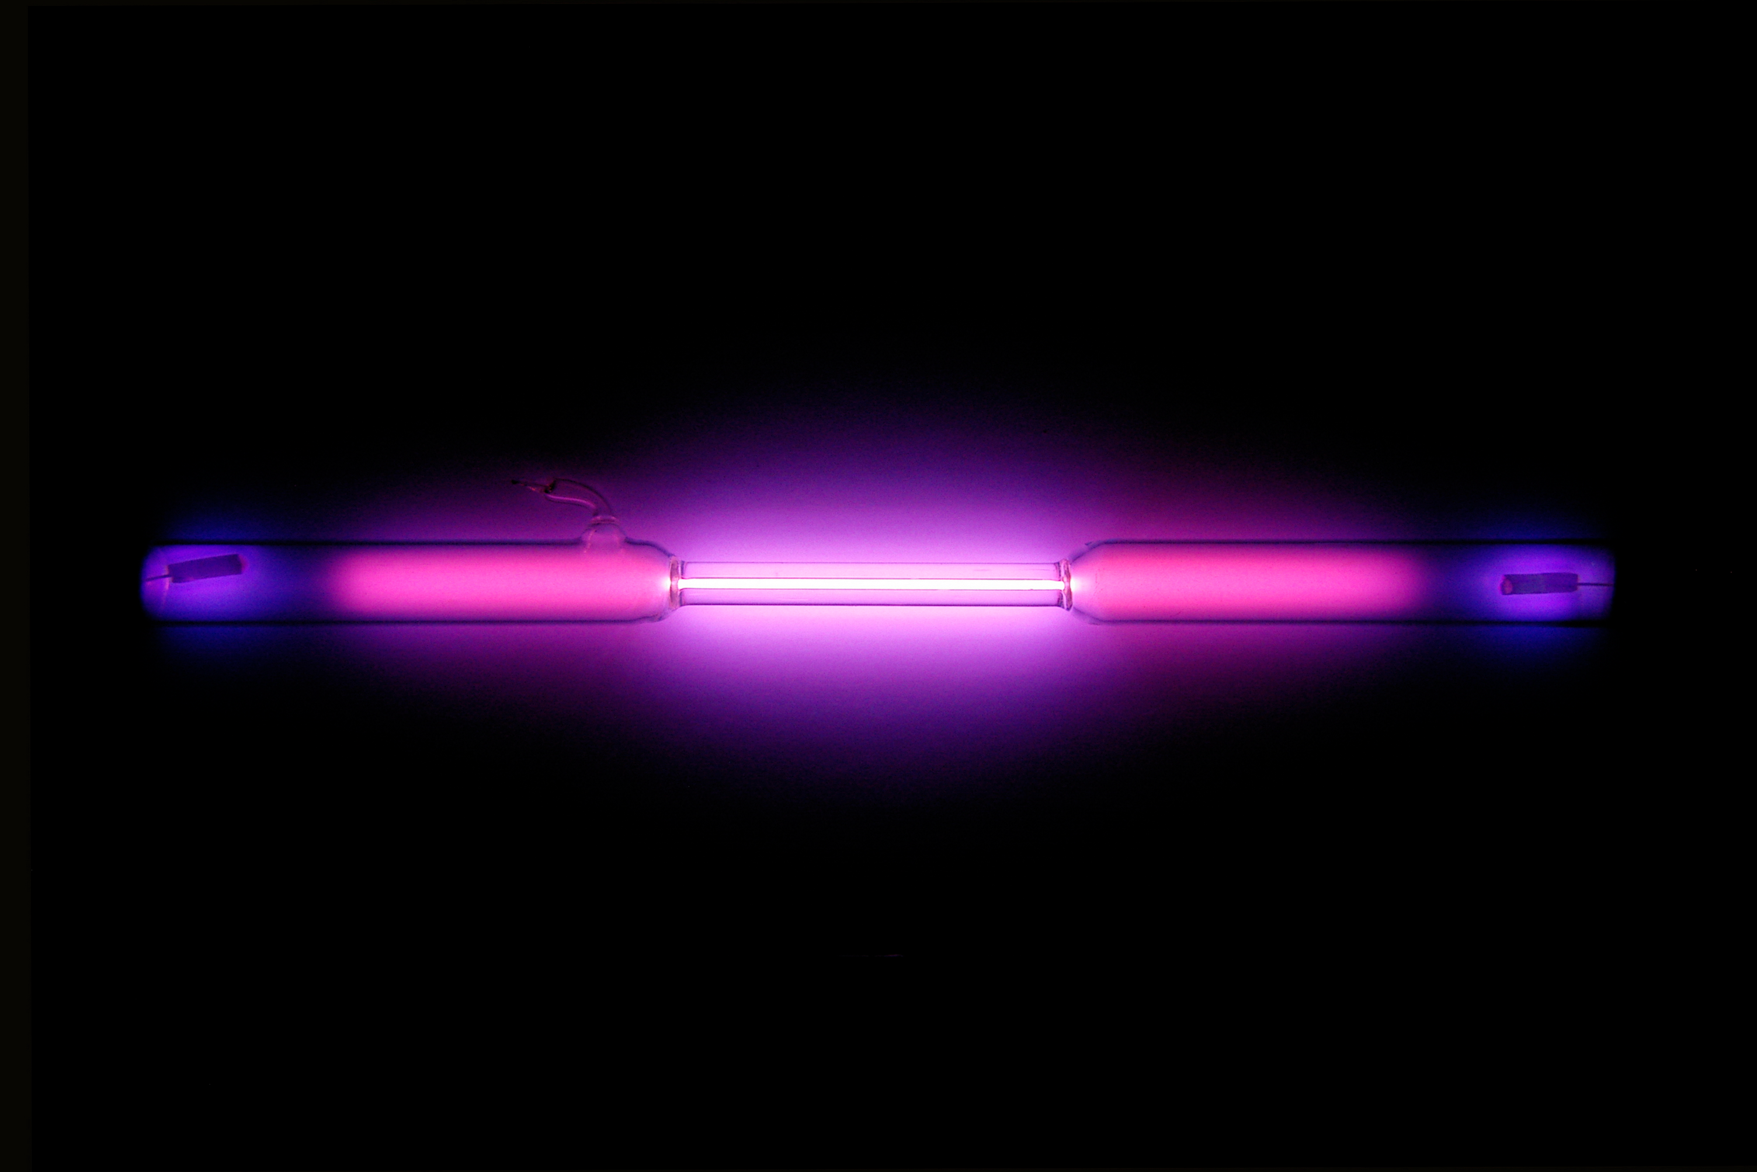
Phase Transitions of Argon
Argon Wikipedia

Slide 2
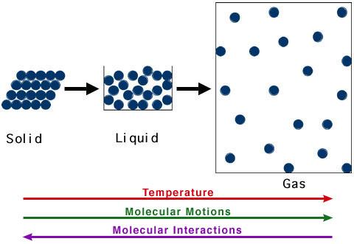
Core Concept
Simulate phase transition of substance
Observe potential energy changes
R. Casiday and R. Frey, Washington University

Slide 3
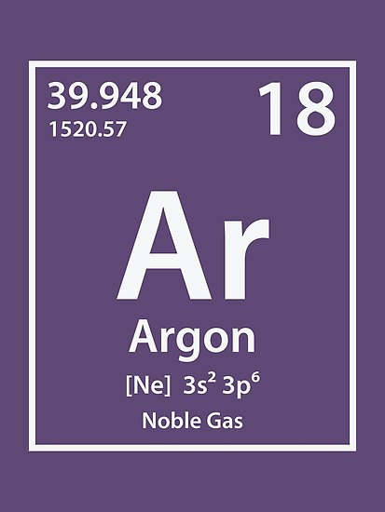
Argon
Noble gas → inert
Does not react
Monoatomic as liquid and gas
Simple Force-Field

Slide 4
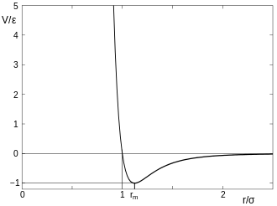
Force-Field
Pauli-Repulsion
Prevents overlapping
London-Dispersion
Induced dipol-dipol interaction
→ Lennard-Jones Potential
Lennard-Jones Potential

Slide 5
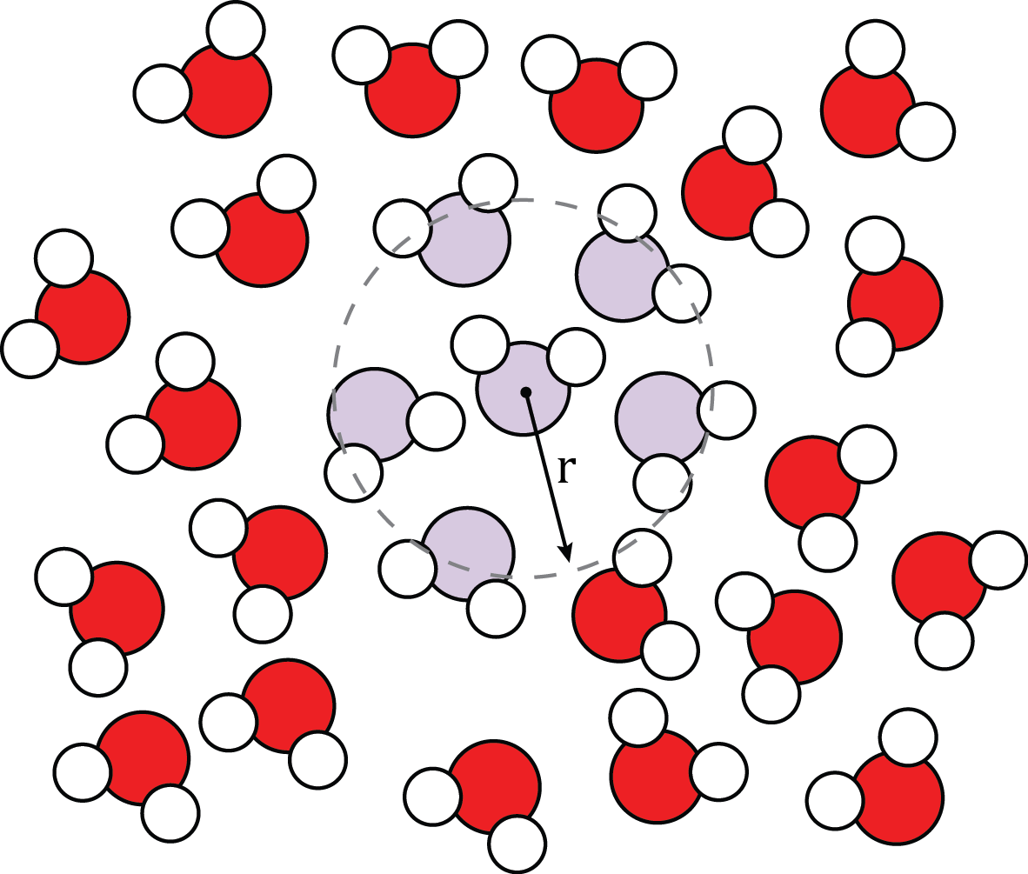
Radial Distribution Function
Defines probabilty to find other Atoms at distance r from a partical at the center
https://en.wikibooks.org/wiki/Molecular_Simulation/Radial_Distribution_Functions#/media/File:Molecular_Schematic_for_Interpreting_a_Radial_Distribution_Function.png

Slide 6
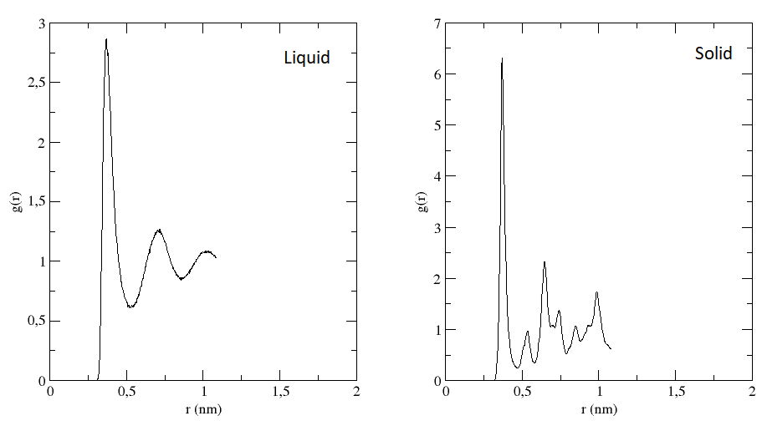
Radial Distribution Function
Notes:
Highest peak → nearest neighbour at ca r=0.37
Solids:
more densly packed → more atoms at given r → higher peaks
The second „big“ peak at twice the distance than first → constant structure
Liquids:
Broader peaks because of more motion(vibration of molecules)
Second peak further away

